Slide 1
BB 3050: Cancer Biology January 15th, 2020
Please sit at one of the tables with a pile of cards on it. The cards will be used for an activity at the end of the class

Slide 2
Cancer Biology BB3050 Dr. Amity Manning
Course materials available on Canvas include:
Syllabus and course schedule
Videos and files to supplement assigned readings
Lectures (after class)
Weekly drop-in review sessions will be held Monday 10-12 with
TA: Liz Cowley eacrowley@wpi.edu
PLA: Alexa Davis abdavis@wpi.edu

Slide 3
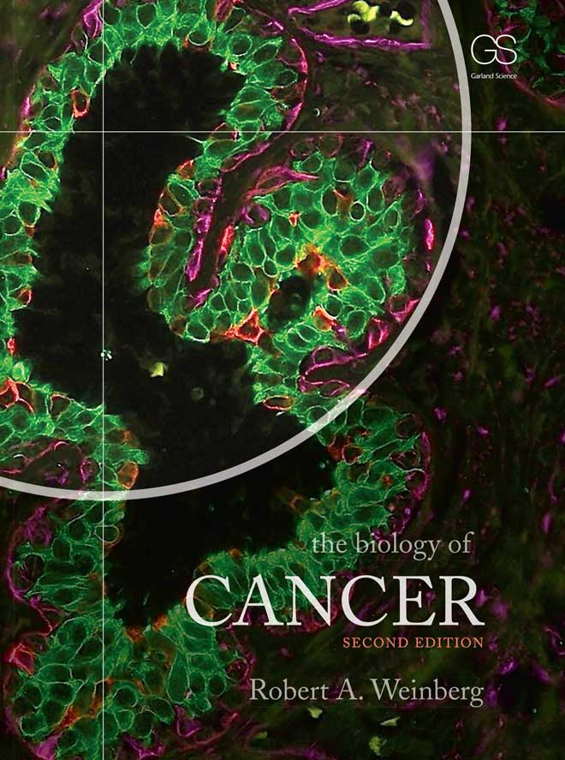
Course overview
This course
Will incorporate small group discussion
Encourage student-led inquiry
Encourage lots of in-class student participation
This course is reading intensive:
We will read nearly all of Weinberg’s “the biology of CANCER” textbook
We will read ~4 primary research articles as a class
Two class projects will require you read self-selected primary research articles (8+)

Slide 4
Course Expectations
Attendance and participation in class is expected
You will be expected to read ~2 chapters from the text book BEFORE the start of each week
In class lectures and workshops will relate to assigned textbook chapters
Grades
4 at-home, low stake (10% total) mini-review assignment will guide your understanding and assess reading comprehension
Taken through the canvas site, due before the start of the week
3 in-class quizzes (20% each) will cover 2-5 chapters of material each
2 related projects (30% total) will investigate the role of specific genes/pathways in cancer biology

Slide 5
Suggested Background
This course will explore how cellular molecules and pathways are corrupted in cancer.
It is expected that you already have a strong knowledge of essential cellular processes → the text and lectures will not cover these basics
If you have not already taken (and done well in):
Genetics
Molecular biology
Cell Biology
You may find it difficult to do well in this course.
Please come see me if you have concerns

Slide 6
Course Objectives
Integrate knowledge of basic biological processes to understand complex human disease
Demonstrate an understanding of the cellular processes that may be corrupted in cancer contexts, the underlying defects, and how such defects contribute to cancer.
Acquire confidence in identifying and understanding primary research articles & interpreting figures and results
Be able to describe experimental approaches that have led to scientific understanding of cancer biology

Slide 7
Chapters 1 & 2: An Overview
Lecture 1 Objectives
Be able to describe the 4 major cell types from which human cancers arise
Be able to discuss major similarities and differences between normal tissue and tumor tissue
Appreciate the diversity of “cancer genes” and begin to understand the cellular processes they regulate

Slide 8
Cancer is prevalent
Many of us know someone who has or has had cancer
But cancer isn’t a modern disease and humans aren’t the only ones who get cancer….

Slide 9
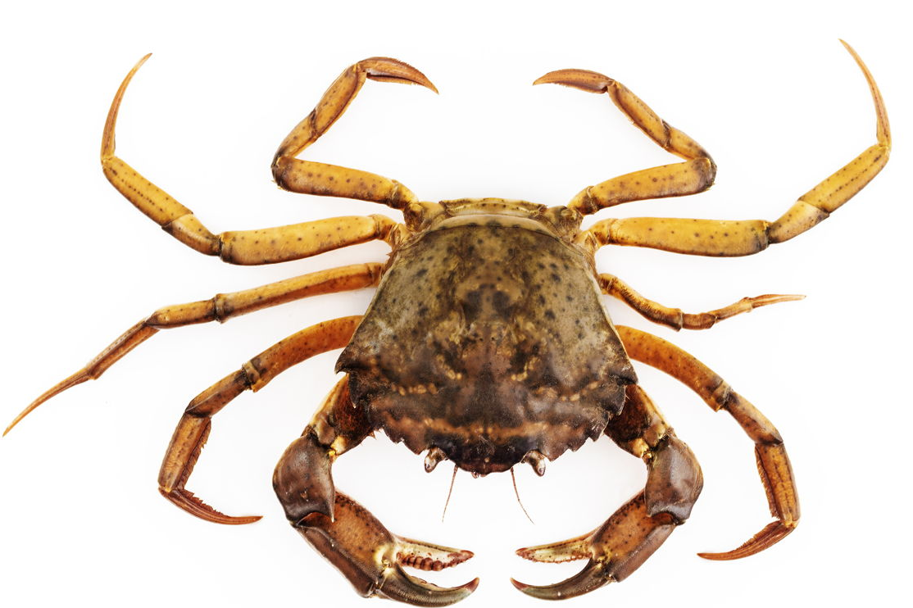
Cancer is prevalent
Many of us know someone who has or has had cancer
But cancer isn’t a modern disease and humans aren’t the only ones who get cancer….
Evidence of cancer is found among 2700 year old fossilized bone tumors (human and animal)& 2200 year old Egyptian mummies
Hippocrates (460-370 BC), the father of Medicine coined the terms carcinos and carcinoma to describe tumors. In Greek, these terms refer to a crab and invoke the invasive nature of cancer

Slide 10
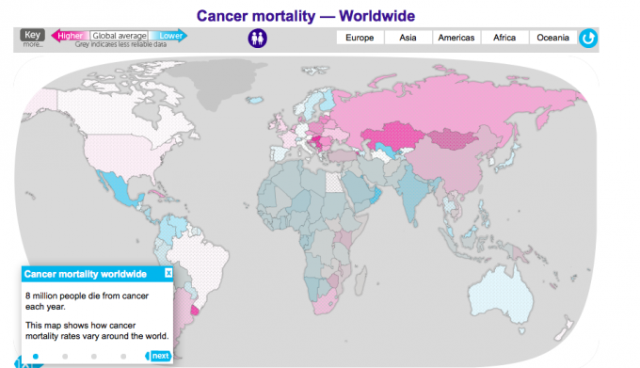
Cancer deaths “today” (2014)
What accounts for the geographic differences in cancer mortality?
Cancer deaths are impacted by both incidence of cancer and successful treatment

Slide 11
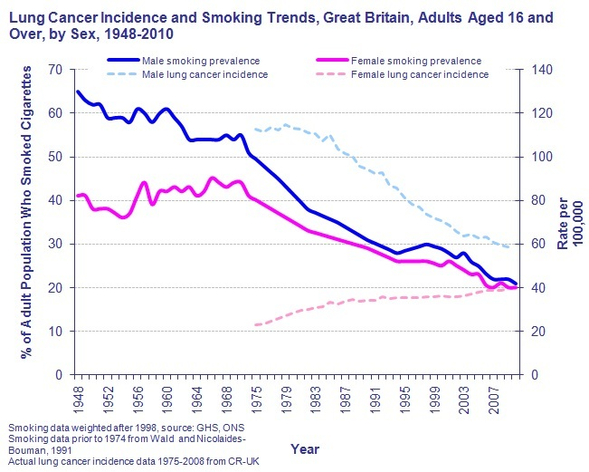
Cancer incidence
In the US, in 2018 alone, 1.7 million new cases of cancer were diagnosed (15,000 were children)
New cancer diagnosis rate is ~1:200 people
~38% of people will be diagnosed with cancer in their lifetime
Lifestyle changes continue to change incidence of cancer
Lung cancer rates pre/post 1970 reflect this
what led to lifestyle changes?
Surgeon general warnings
Why don’t lung cancer rates in women decrease?

Slide 12
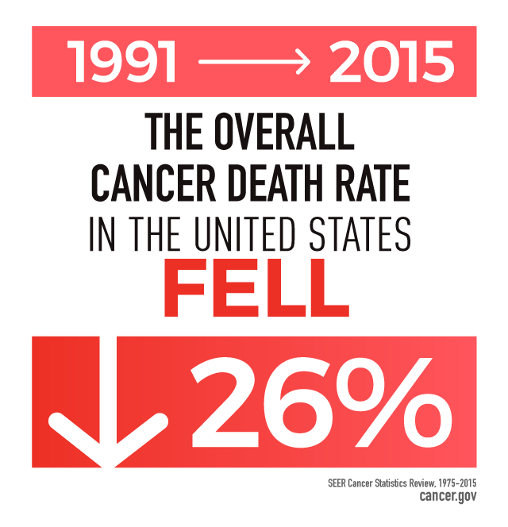
Cancer detection and treatment
Early diagnosis and improved treatment continue to improve cancer survival (~1.4 to 1.8% per year)
1960s to now:
Overall survival rates increased from ~30% to ~70%
“War on Cancer”: Pres. Nixon signed the National Cancer Act in 1971 → increased federal funding for basic and translational cancer research
Significant progress in the understanding of:
Cancer biology
Risk factors
Treatments
prognosis

Slide 13
Cancer treatment and cure
Even so >600,000 people in the US (1,790 children) died in 2018 from cancer
Cancer remains one of the leading causes of death in the developed world (2nd only to heart disease in US)
Challenges persist:
Inherent biological complexity: cells are complex!
Disease heterogeneity: different cancers = some shared & some different traits
Technological limitations: detection & treatment/drug design
Implementation of preventative measures: education, cost and compliance
What do we know? How do we know it? What do we still have to learn?

Slide 14
Cancer: a brief historical overview
Tumors arise from normal tissue
Once believed to be foreign bodies that have invaded a person
Discoveries in the mid/late 19th century revealed instead that tumors derive from a cancer patients own tissues
Tumors maintain many features of the tissue of origin

Slide 15
Cancer cells reflect the tissue of origin
MOST tumors are benign and harmless.
In rare cases benign tumors cause problems
How might benign tumors can cause clinical symptoms?
90% of cancer deaths are a result of metastases that result from malignant tumors.
Why might a metastasis compromise health when a benign tumor of similar origin does not?
Tumors that grow locally are termed benign
Tumors that invade nearby tissues are termed malignant
Malignant tumors that travel to distant tissue are metastatic

Slide 16
Successful treatment depends on
Finding the tumor (and removing it!)
Predicting where the tumor might have/will metastasize to or where it metastasized from
Targeting attributes/cell-specific features of the tumor
Knowing the tissue of origin informs these approaches

Slide 17
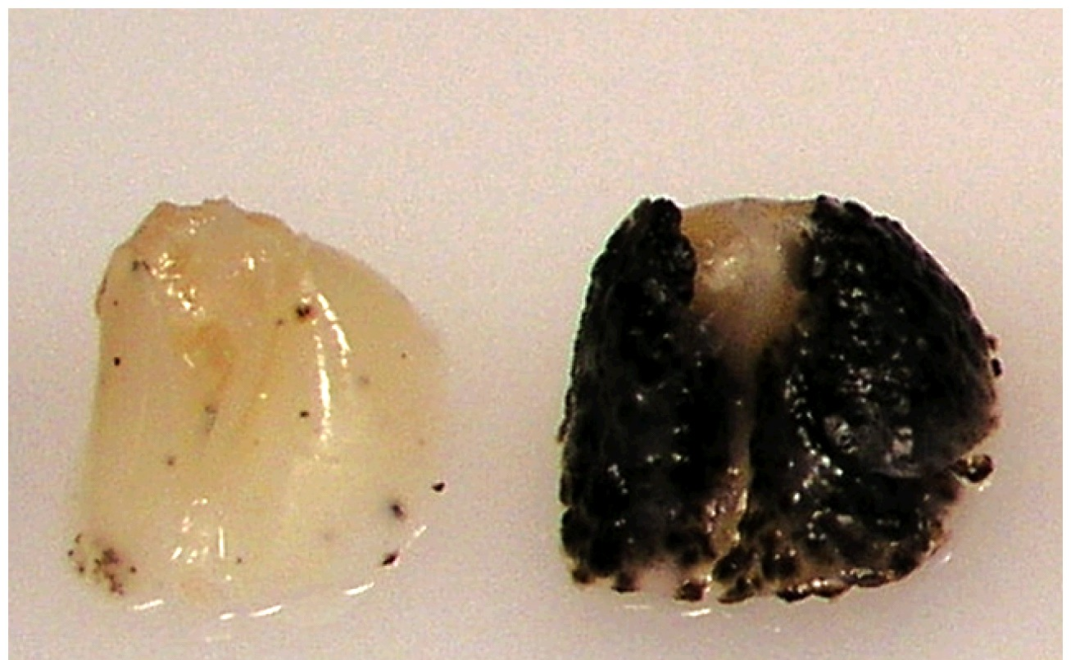
Identifying cancer cells
A benign tumor that remains within its tissue of origin may be easy to characterize and remove
Even cancer cells that metastasize maintain features of the tissue of origin that aid in their characterization
Example:
Melanoma cells are pigmented
Melanoma metastases on the lung maintain pigmentation and other features of melanocytes

Slide 18
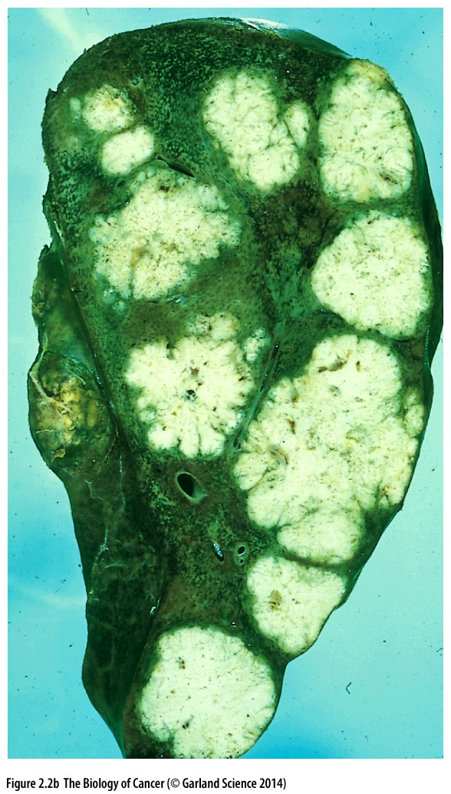
Tracking cancer cells
Knowing where a cancer comes from(tissue of origin) can inform where its been AND where it might spread to next
Cancers that metastasize often do so predictably
Example:
The portal vein drains blood from the colon into the liver and provides a route for colon cancer metastases

Slide 19
Tissue of origin features maintained
Tissue architecture
Histological features (structural organization of the tissue)
Gene expression
Cellular function
What are some functions that cells can have?
Why might a cancer cell with these functions be a problem?

Slide 20
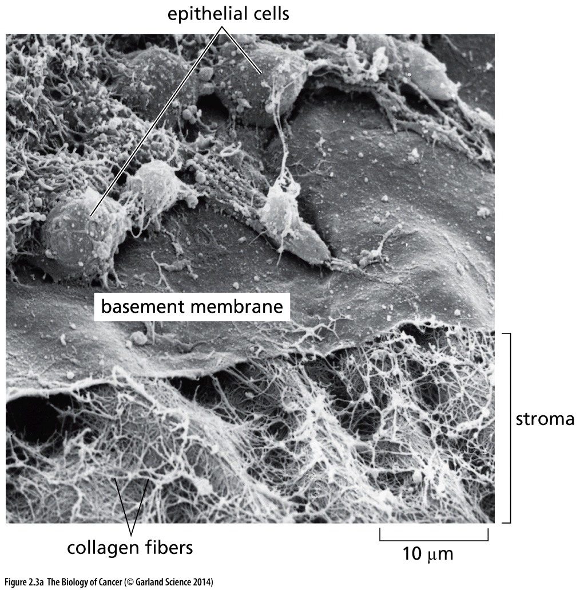
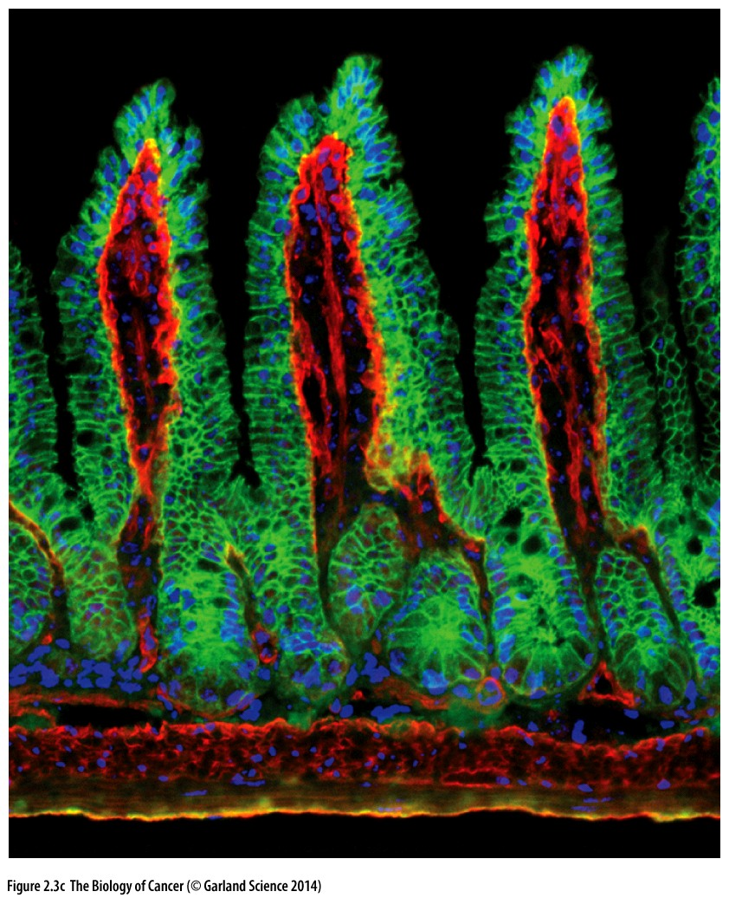
Most cancers are derived from epithelial cells
Epithelial cells are present in many organs/tissues
Sheets of cells that line the walls of cavities and channels
Normal tissue containing are epithelia structured similarly
Epithelial cells lie above the basement membrane

Slide 21
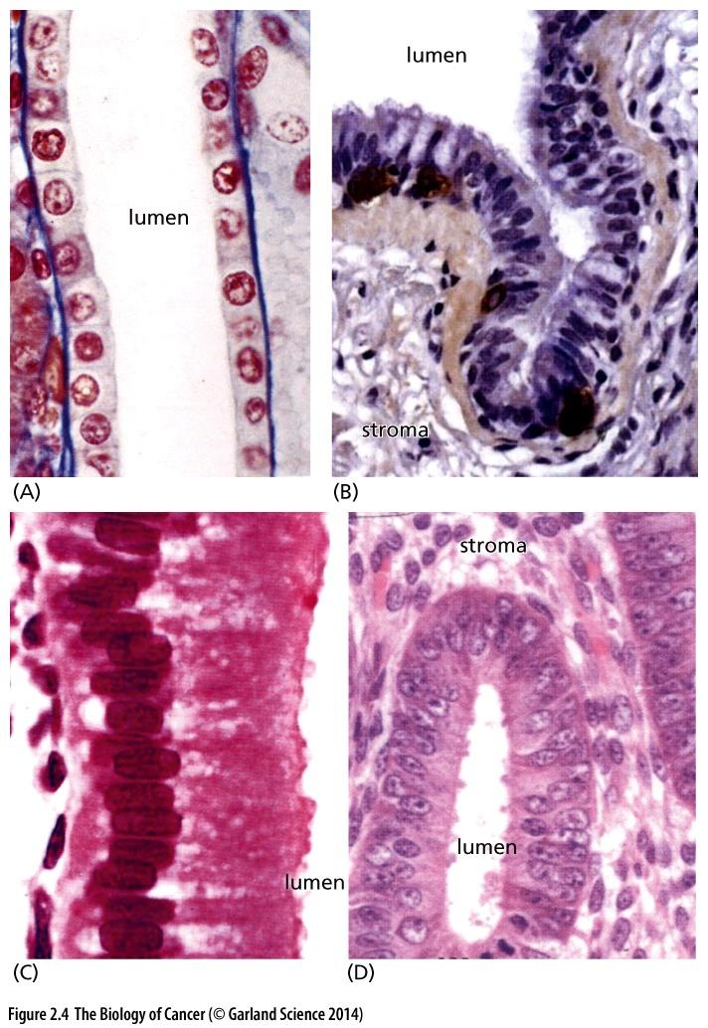
Epithelial cell organization
Kidney
lung
Epithelial cells provide a barrier to protect the underlying tissue from the contents of the lumen (gut, lung) or outside world
Tissue that normally forms barriers
Tissue that normally line ducts/cavities and secrete substances
gallbladder
uterus

Slide 22
What causes cancer?
Cancer is a genetic* disease
Changes (mutations) that promote cancer occur at the gene level and influence how genes are regulated or function
*most of the time. More on this later

Slide 23
What kinds of genes are mutated
take 3-4 cards from the center of the table
Each cancer gene card
gene symbol
Chromosome location
Gene classification
Oncogene
tumor suppressor
Function/role of altered gene in cancer
Cell fate
Cell survival
Genome maintenance

Slide 24
Mini Workshop: Classifying Cancer Genes
Compare the chromosomal locations of your genes to those of others in your group.
From this discussion, can you infer anything about where cancer genes are located?

Slide 25
Cancer genes are found throughout the genome

Slide 26
Mini Workshop: Classifying Cancer Genes
Discuss at your table which aspects of cancer might be dependent on the function your gene regulates
how many functions might one mutated gene influence?
What might you infer about the kind of mutation needed in a cell survival gene to cause cancer?
A cell fate gene?
A genome stability gene?
Can you predict how many genes might need to be altered to initiate cancer?

Slide 27
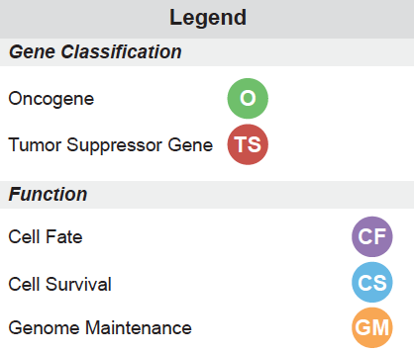
What can tumors tell us?
Each card represents a real patient whose tumor genome has been sequenced to identify “cancer genes” responsible for that tumor’s growth
Group according to the 8 types of cancer: (hepatic, colorectal, leukemia, melanoma, breast, pancreatic, glioma, and lung)
What trends emerge?
Group according to patient number (1, 2, 3, 4)
What is similar among patients/tumors? What is different?

Slide 28
Lectures this week
Lecture 3 prep
Cancer Genetics Workshop
TONIGHT or TOMORROW: view the “cancer as a genetic disease” video clip and complete the related worksheet
FRIDAY: bring your completed worksheet and be prepared for small group workshop and discussion
Use www.genecards.org to look up the function of your 3-4 genes. Fill in the details for your genes in the “Cancer Genes” discussion board on the canvas site.
Lecture 2 and 3 lecture content
Review major ways in which DNA is altered (mutated) and discuss the implications of such changes on protein function

